Slide 1
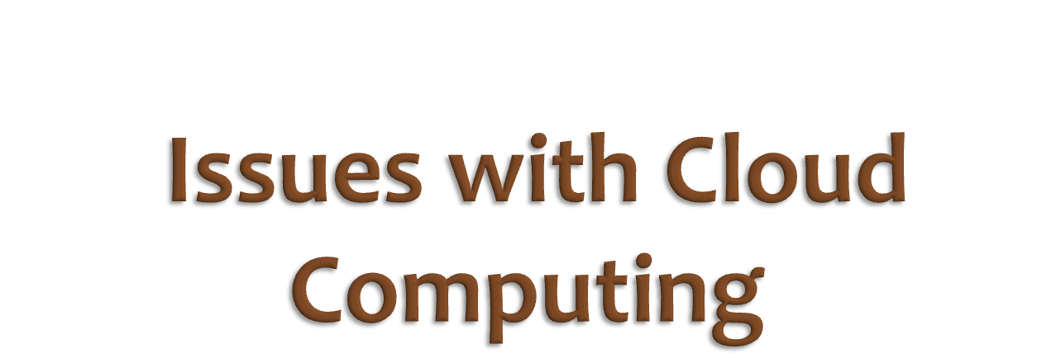

Slide 2

Cloud computing provides unlimited infrastructure to store and execute customer data and program.
As customers you do not need to own the infrastructure, they are merely accessing or renting, they can forego capital expenditure and consume resources as a service, paying instead for what they use.
Benefits of Cloud Computing :
Minimized Capital expenditure
Location and Device independence
Utilization and efficiency improvement
Very high Scalability
High Computing power

Slide 3

In the last few years, cloud computing has grown from being a promising business concept to one of the fast growing segments of the IT industry.
But as more and more information on individuals and companies are placed in the cloud, there is an increasing concern in the mind’s of everyone about just how safe a cloud environment is.
Despite of all the hype surrounding the cloud, customers are still reluctant to deploy their business in the cloud.
Security issues in cloud computing has played a major role in slowing down its acceptance,

Slide 4
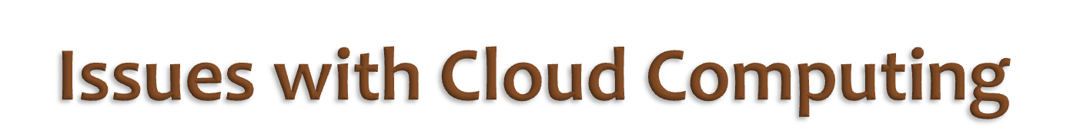
According to a survey conducted by IDC in 2008, the major challenges that prevent Cloud Computing from being adopted are recognized by organizations are as follows:
Security
Costing Model
Charging Model
Service Level Agreement (SLA)
What to migrate
Cloud Interoperability Issue

Slide 5
Security
It is clear that the security issue has played the most important role in affecting Cloud computing acceptance.
For people putting your own data, running your software on someone else's hard disk using someone else's CPU appears daunting to many.
Well-known security issues such as data loss, phishing, botnet pose serious threats to organization's data and software.
Moreover, the multi-tenancy model and the pooled computing resources in cloud computing has introduced new security challenges that require novel techniques to tackle with.
For example, hackers can use Cloud to organize botnet as Cloud often provides more reliable infrastructure services at a relatively cheaper price for them to start an attack.

Slide 6
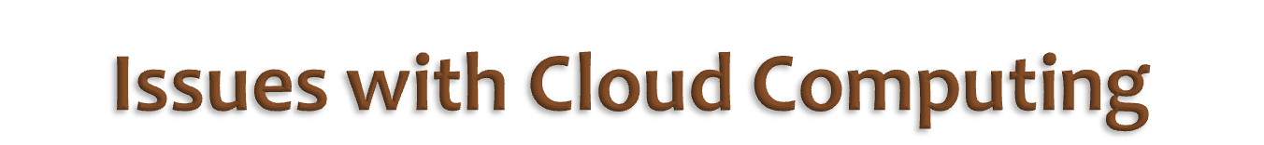
Costing Model
Cloud consumers must consider the tradeoffs amongst computation, communication, and integration.
While migrating to the Cloud can significantly reduce the infrastructure cost, it does raise the cost of data communication, i.e. the cost of transferring an organization's data to and from the public and community Cloud and the cost per unit of computing resource used is likely to be higher.
This problem is particularly prominent if the consumer uses the hybrid cloud deployment model where the organization's data is distributed amongst a number of public/private (in-house IT infrastructure)/community clouds.
On-demand computing makes sense only for CPU intensive jobs

Slide 7
Charging Model
The elastic resource pool has made the cost analysis a lot more complicated than regular data centers, which often calculates their cost based on consumptions of static computing.
Moreover, an instantiated virtual machine has become the unit of cost analysis rather than the underlying physical server.
For SaaS cloud providers, the cost of developing multi-tenancy within their offering can be very substantial.
These include: re-design and re-development of the software that was originally used for single-tenancy, cost of providing new features that allow for intensive customization, performance and security enhancement for concurrent user access, and dealing with complexities induced by the above changes.
Consequently, SaaS providers need to weigh up the trade-off between the provision of multi-tenancy and the cost-savings yielded by multi-tenancy such as reduced overhead through amortization, reduced number of on-site software licenses, etc.
Therefore, a strategic and viable charging model for SaaS provider is crucial for the profitability and sustainability of SaaS cloud

Slide 8
Service Level Agreement (SLA)
cloud consumers do not have control over the underlying computing resources.
Thus they do need to ensure the quality, availability, reliability, and performance of these resources when consumers have migrated their core business functions onto their entrusted cloud.
It is vital for consumers to obtain guarantees from providers on service delivery.
Typically, these are provided through Service Level Agreements (SLAs) negotiated between the providers and consumers.
The very first issue is the definition of SLA specifications in such a way that has an appropriate level of granularity, namely the tradeoffs between expressiveness and complicatedness, so that they can cover most of the consumer expectations and is relatively simple to be weighted,verified, evaluated, and enforced by the resource allocation mechanism on the cloud. In addition, different cloud offerings (IaaS, PaaS, and SaaS) will need to define different SLA specifications.
This also raises a number of implementation problems for the cloud providers. Furthermore, advanced SLA mechanisms need to constantly incorporate user feedback and customization features into the SLA evaluation framework.

Slide 9
What to migrate
Based on a survey conducted by IDC in 2008, the seven
IT systems/applications being migrated to the cloud are:
IT Management Applications (26.2%),
Collaborative Applications (25.4%),
Personal Applications (25%),
Business Applications (23.4%),
Applications Development and Deployment (16.8%),
Server Capacity (15.6%),
and Storage Capacity (15.5%).
This result reveals that organizations still have security/privacy concerns in moving their data on to the Cloud.
Currently, peripheral functions such as IT management and personal applications are the easiest IT systems to move.
Organizations are conservative in employing IaaS compared to SaaS.
This is partly because marginal functions are often outsourced to the Cloud, and core activities are kept in-house.

Slide 10
Cloud Interoperability Issue
Currently, each cloud has its own way on how cloud Clients/applications/users interact with the cloud.
This prohibits the ability of users to choose from alternative vendors/offering simultaneously in order to optimize resources at different levels within an organization.
More importantly, proprietary cloud APIs makes it very difficult to integrate cloud services with an organization's own existing legacy systems
The primary goal of interoperability is to realize the seamless fluid data across clouds and between cloud and local applications.
There are a number of levels that interoperability is essential for cloud computing. First, to optimize the IT asset and computing resources, an organization often needs to keep in-house IT assets and capabilities associated with their core competencies while outsourcing marginal functions and activities (e.g. the human resource system) on to the cloud.
Second, more often than not, for the purpose of optimization,an organization may need to outsource a number of marginal functions to cloud services offered by different vendors.
Standardization appears to be a good solution to address the interoperability issue.

Slide 11
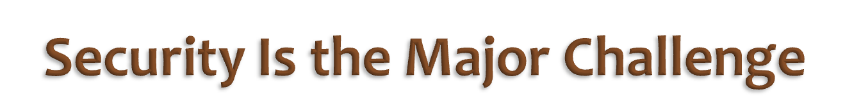
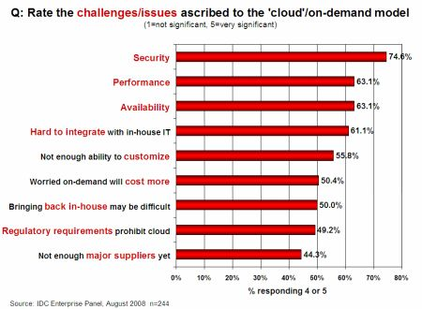

Slide 12
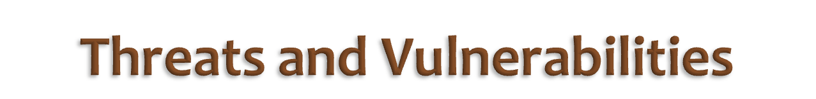
Security is to save data and program from Threats and vulnerability
Threats
Disrupts Services.
Theft of Information.
Loss of Privacy.
Damage information.
Vulnerabilities
Hostile Program.
Hostile people giving instructions to good programs.
Bad guys corrupting or eavesdropping on communications

Slide 13
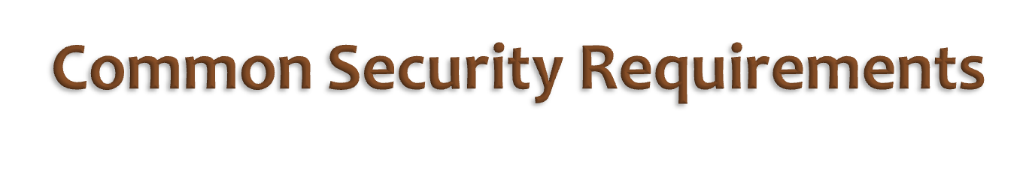
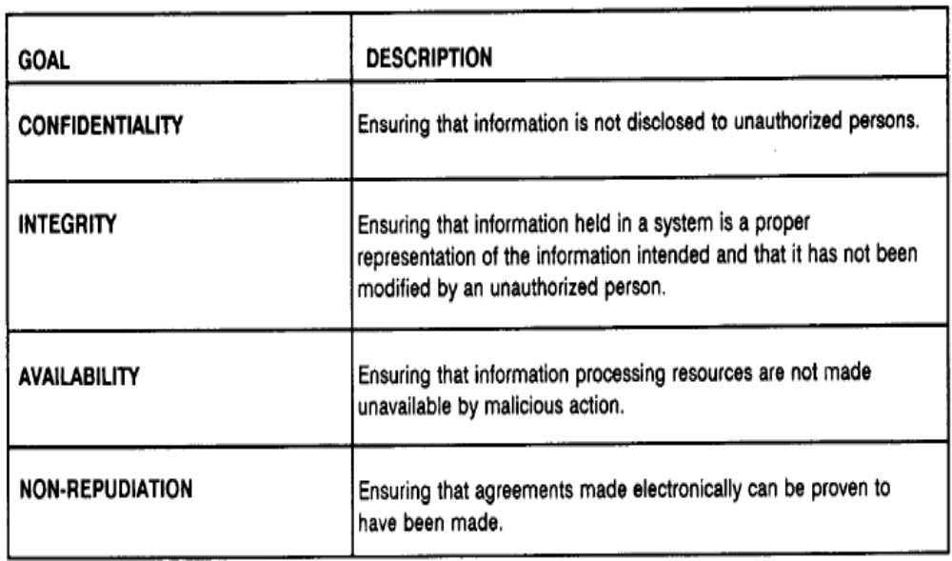

Slide 14
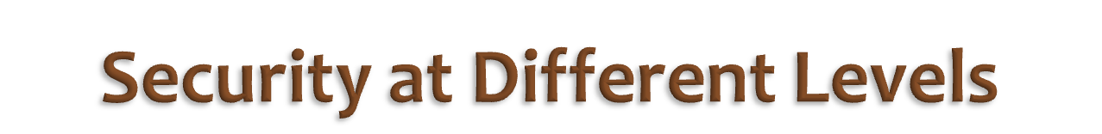
We need Security at following levels:
Server access security
Internet access security
Database access security
Data privacy security
Program access Security

Slide 15
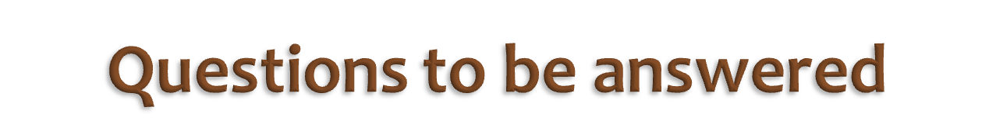
How much secure is the Data?
How much secure is the Code?
Isolation of user data in case of shared resources?
What is Data Security at Physical Layer?
What is Data Security at Network Layer?
What about investigation Support?
How much safe is data from Natural disaster?
How much trusted is Encryption scheme of Service Provider?

Slide 16
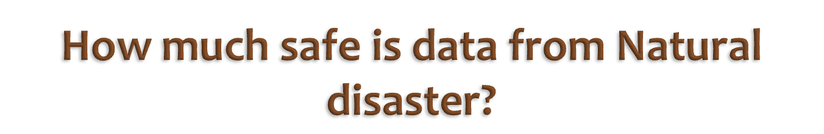
Is cloud infrastructure ready for any kind of natural disaster?
A customer should make sure that the cloud provider follows a standard risk analysis procedure.
Data can be redundantly store in multiple physical location.
Physical location should be distributed across world.

Slide 17


Does cloud provider has a security policy for HR and Employees?
Does cloud provider performs a background check on employees while hiring them?
Does the cloud provider has employee termination policy?
Does cloud provider has Professional Security staff utilizing video surveillance, state of the art intrusion detection systems, and other electronic means to control physical access?
When an employee no longer has a business need to access datacenter his privileges to access datacenter should be immediately revoked.
Does cloud provider maintains a log of all physical and electronic access to data centers by employees or third parties and audits them regularly?

Slide 18

DropBox,the fast-growing private company that lets you share documents easily online, continues to experience significant security breaches in its service, announcing this time that some user usernames and passwords were stolen “from other websites,” and their accounts accessed.
It also said that an account of one of its employees was broken into, and that it believes user email addresses were stolen from a document accessed from that account.

Slide 19
The news follows two other high-profile instances of security problems at the company.
A year ago, Dropbox disclosed that all of its users’ files were publicly accessible for nearly four hours due to a bug in the company’s authentication mechanism. During that time, anyone could access a Dropbox account without using the correct password.
And in April, a security hole was discovered in Dropbox’s iOS app, which allowed anyone with physical access to your phone to copy your login credentials — because it stored user login information in unencrypted text files.

Slide 20

When user use the cloud, user probably won't know exactly where your data is hosted, what country it will be stored in?
Data should be stored and processed only in specific jurisdictions as define by user.
Provider should also make a contractual commitment to obey local privacy requirements on behalf of their customers,
Data-centered policies that are generated when a user provides personal or sensitive information, that travels with that information throughout its lifetime to ensure that the information is used only in accordance with the policy

Slide 21
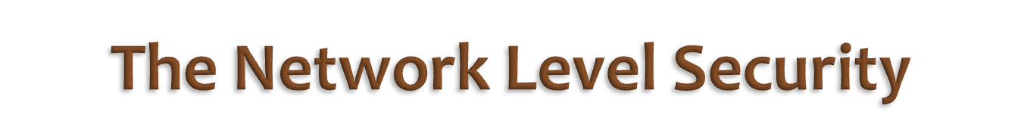
The customer data always travels over Internet.
The cloud provider should provide means to secure this transmission, as Internet poses a biggest threat of unauthorized access to data.
Ensuring confidentiality and integrity of your organization’s data-in-transit to and from your public cloud provider
Ensuring proper access control (authentication, authorization, and auditing) to whatever resources you are using at your public cloud provider
Ensuring availability of the Internet-facing resources in a public cloud that are being used by your organization, or have been assigned to your organization by your public cloud providers

Slide 22

In case of IaaS , the virtual machines of different users may be running on the same physical server. Is the isolation done correctly?
  Multiple VMs of different organizations with virtual boundaries separating each VM can run within one physical server
  "virtual machines" still have IP addresses, visible to anyone within the cloud.
  VMs located on the same physical server tend to have IP addresses that are close to each other.
  An attacker can set up lots of his own virtual machines, look at their IP addresses, and figure out which one shares the same physical resources as an intended target.
  Once the malicious virtual machine is placed on the same server as its target, it is possible to carefully monitor how access to resources fluctuates and thereby potentially gain sensitive information about the victim

Slide 23
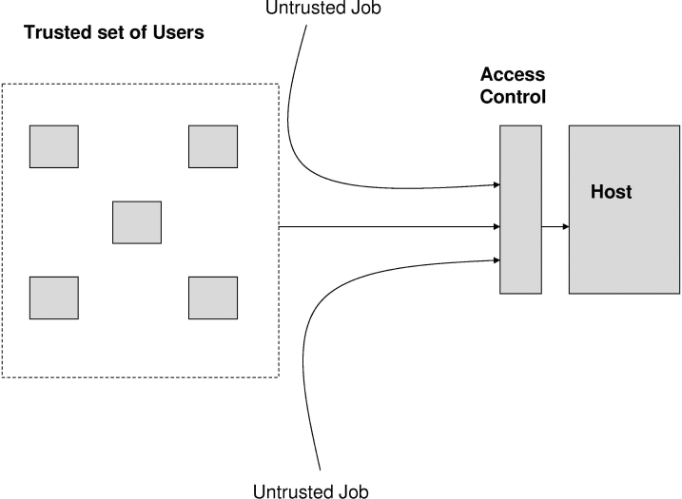
The host running the job, the job may well be a virus or a worm which can destroy the system
From malicious users
Solution: A trusted set of users is defined through the distribution of digital certification, passwords, keys etc. and then access control policies are defined to allow the trusted users to access the resources of the hosts.

Slide 24
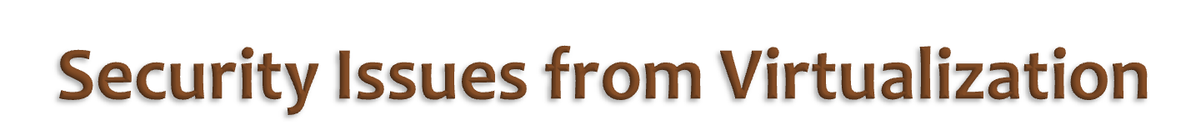
Type of virtualization provider is using- Para-Virtualization or full system virtualization.
Instance Isolation: ensuring that Different instances running on the same physical machine are isolated from each other.
Control of Administrator on Host O/s and Guest o/s.
Current VMMs do not offer perfect isolation: Many bugs have been found in all popular VMMs that allow to escape from VM!
Virtual machine monitor should be ‘root secure’, meaning that no level of privilege within the virtualized guest environment permits interference with the host system.

Slide 25
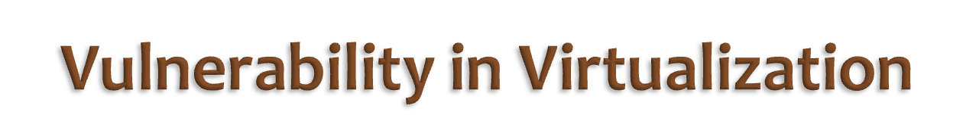
Some vulnerabilities have been found in all virtualization software, which can be exploited by malicious, local users to bypass certain security restrictions or gain escalated privileges. For ex.
The vulnerability in Microsoft Virtual PC and Microsoft Virtual Server could allow a guest operating system user to run code on the host or another guest operating system.(Vulnerability in Virtual PC and Virtual Server Could Allow Elevation of Privilege )
A vulnerability was found in VMware's shared folders mechanism that grants users of a Guest system read and write access to any portion of the Host's file system including the system folder and other security-sensitive files.
A vulnerability in Xen is caused due to an input validation error in tools/pygrub/src/GrubConf.py. This can be exploited by "root" users of a guest domain to execute arbitrary commands in domain 0 via specially crafted entries in grub.conf when the guest system is booted.

Slide 26

VMM Should support following properties:
Isolation :Software running in a virtual machine cannot access or modify the software running in the VMM or in a separate VM.
Inspection: The VMM has access to all the state of a virtual machine: CPU state (e.g. registers), all memory, and all I/O device state such as the contents of storage devices and register state of I/O controllers. So that VMM can monitor VM.
Interposition: Fundamentally, VMMs need to interpose on certain virtual machine operations (e.g. executing privileged instructions). For ex. if the code running in the VM attempts to modify a given register.

Slide 27
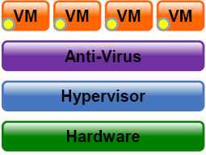
SOME KIND OF PROTECTION MECHANISM LIKE FIREWALL OR ANTI-VIRUS IS REQUIRED TO CONTROL COMMUNICATION BETWEEN VIRTUAL MACHINES ON A SINGLE PHYSICAL SERVER.

Slide 28

Issues related to Saas or PaaS clouds:
Is the application developed securely?
Is the application tested for application vulnerabilities like buffer overflow etc.?
Does provider follows any policy to perform security tests of an application?
How modification or patching is done?
Are this tested before applying to production environment?
Is the platform I use for development a secure one?
Which encryption algorithms are supported?
Can I use my own algorithms?
Can I perform pentest on my application?

Slide 29
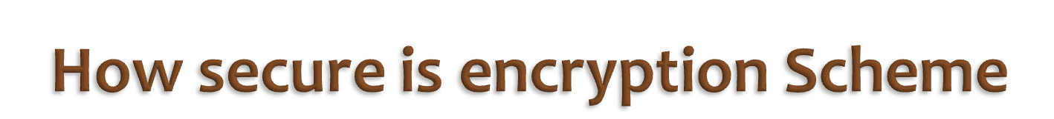
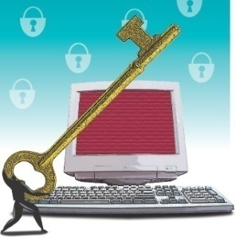
Is it possible for all of my data to be fully encrypted?
What algorithms are used?
Who holds, maintains and issues the keys?
Problem:
Encryption accidents can make data totally unusable.
Encryption can complicate availability Solution
The cloud provider should provide evidence that encryption schemes were designed and tested by experienced specialists.

Slide 30

Data store in database of provider should be redundantly store in multiple physical location.
Who will backup the data? Customer or provider?
Will provider backup individual data or combined data of all the customer’s?
What if a customer requires to retain a backup copy of the data?
Protection of Backup data?
Restoration of data in case of accidental deletions?
Control of Administrator on Databases.

Slide 31

The hack into a writer€™s Amazon and Apple accounts over the weekend is being used as a cautionary tale for consumers, a call to action for cloud providers regarding security policies and a sounding board for concerns about the rush to the cloud.

Slide 32
In a lengthy first-person account in Wired magazine, writer Mat Honan outlines how an attacker quickly found his way into Honan€™s iCloud account and wiped everything from his Mac, iPhone and iPad, all of which were linked to Apple€™s cloud service. The attacker also hacked into his Twitter and Gmail accounts. In the story, Honan admonishes himself for failing to follow basic security protocol€”his online accounts were linked together, and he had failed to back up his data, for example.

Slide 33

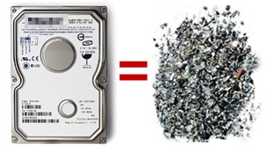
Sanitization is the process of removing sensitive information from a storage device.
What happens to data stored in a cloud computing environment once it has passed its user’s “use by date”
What data sanitization practices does the cloud computing service provider propose to implement for redundant and retiring data storage devices as and when these devices are retired or taken out of service.

Slide 34

Security related to the information exchanged between different hosts or between hosts and users.
This issues pertaining to secure communication, authentication, and issues concerning single sign on and delegation.
Secure communication issues include those security concerns that arise during the communication between two entities.
These include confidentiality and integrity issues. Confidentiality indicates that all data sent by users should be accessible to only “legitimate” receivers, and integrity indicates that all data received should only be sent/modified by “legitimate” senders.
Solution: public key encryption, X.509 certificates, and the Secure Sockets Layer (SSL) enables secure authentication and communication over computer networks.

Slide 35

Management Related Issues:
Management is important as the cloud is heterogeneous in nature and may consist of multiple entities, components, users, domains, policies, and stake holders.
Credential Management:Credential management systems store and manage the credentials for a variety of systems and users can access them according to their needs.
Secure and safe storage of credentials is equally important.

Slide 36

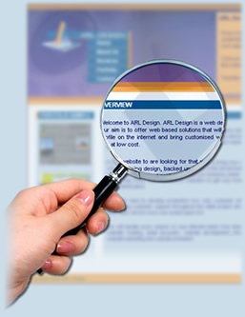
Investigating inappropriate or illegal activity may be difficult in cloud computing because
-- logging and data for multiple customers may be co-located
-- may also be geographically spread across an ever-changing set of hosts and data centers.
Solution: get a contractual commitment to support specific forms of investigation, along with evidence that the vendor has already successfully supported such activities.

Slide 37
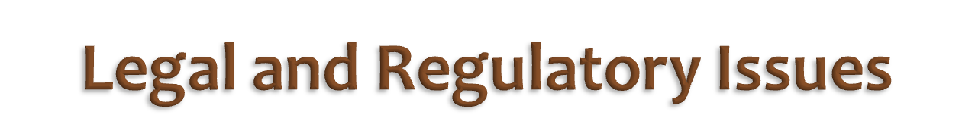
Laws and regulations may prevent cloud computing
• Requirements to retain control
• Certification requirements not met by provider
• Geographical limitations – EU Data Privacy
• New locations may trigger new laws and regulations
Compliance Issues
  Customer may require compliance with standards like PCI DSS, HIPPA, SOX
Countermeasures
• Evaluate legal issues
• Require provider compliance with laws and regulations
• Restrict geography as needed

Slide 38

R1: Accountability & Data Risk
R2: User Identity Federation
R3: Regulatory Compliance
R4: Business Continuity & Resiliency
R5: User Privacy & Secondary Usage of Data
R6: Service & Data Integration
R7: Multi-tenancy & Physical Security
R8: Incidence Analysis & Forensics
R9: Infrastructure Security
R10: Non-production Environment Exposure

Slide 39
A1. Cross-Site Scripting (XSS)
A2. Injections Flaws
A3. Malicious File Execution
A4. Insecure Direct Object Reference
A5. Cross Site Request Forgery (CSRF)
A6. Information Leakage & Improper Error Handling
A7. Broken Authentication & Session Management
A8. Insecure Cryptographic Storage
A9. Insecure Communications
A10. Failure to Restrict URL Access

Slide 40

http://venturebeat.com/2012/08/01/dropbox-has-become-problem-child-of-cloud-security/
http://www.eweek.com/c/a/Security/Apple-iCloud-Hack-Raises-Concerns-Over-Cloud-Security-609440/

Slide 41
